Slide 1
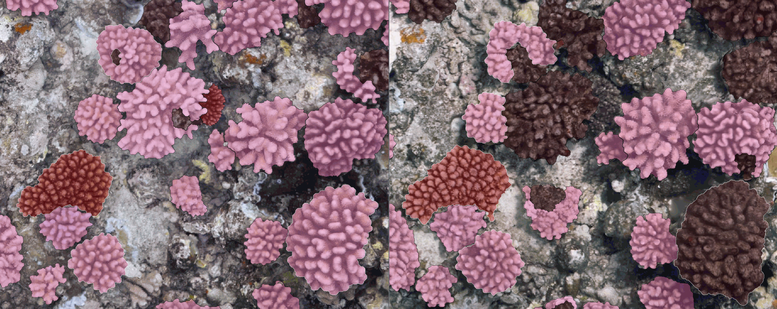
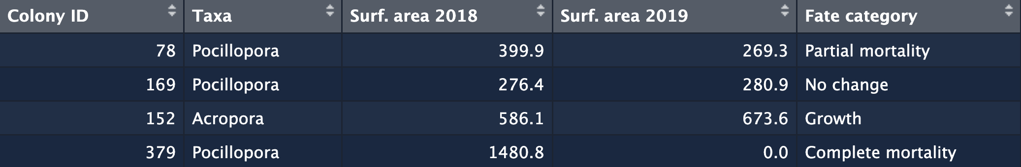
Figure 1
2018
2019
10 cm
78
Partial mortality
169
No change
152
Growth
379
Complete mortality

Slide 2
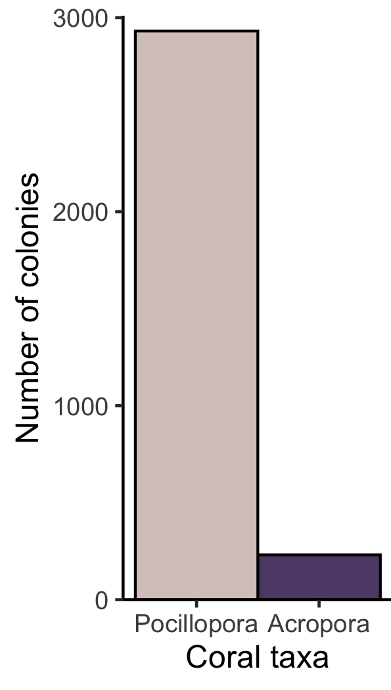
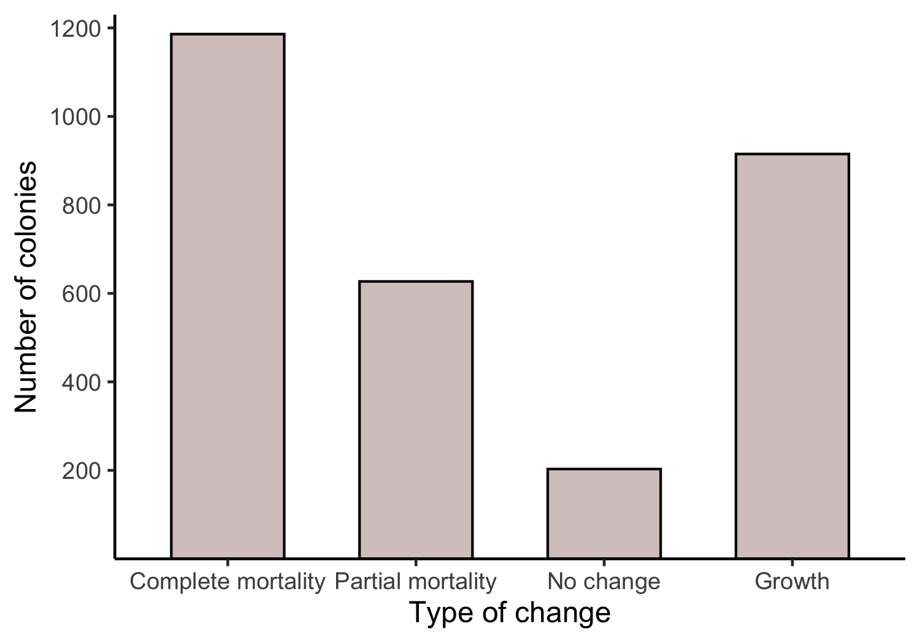
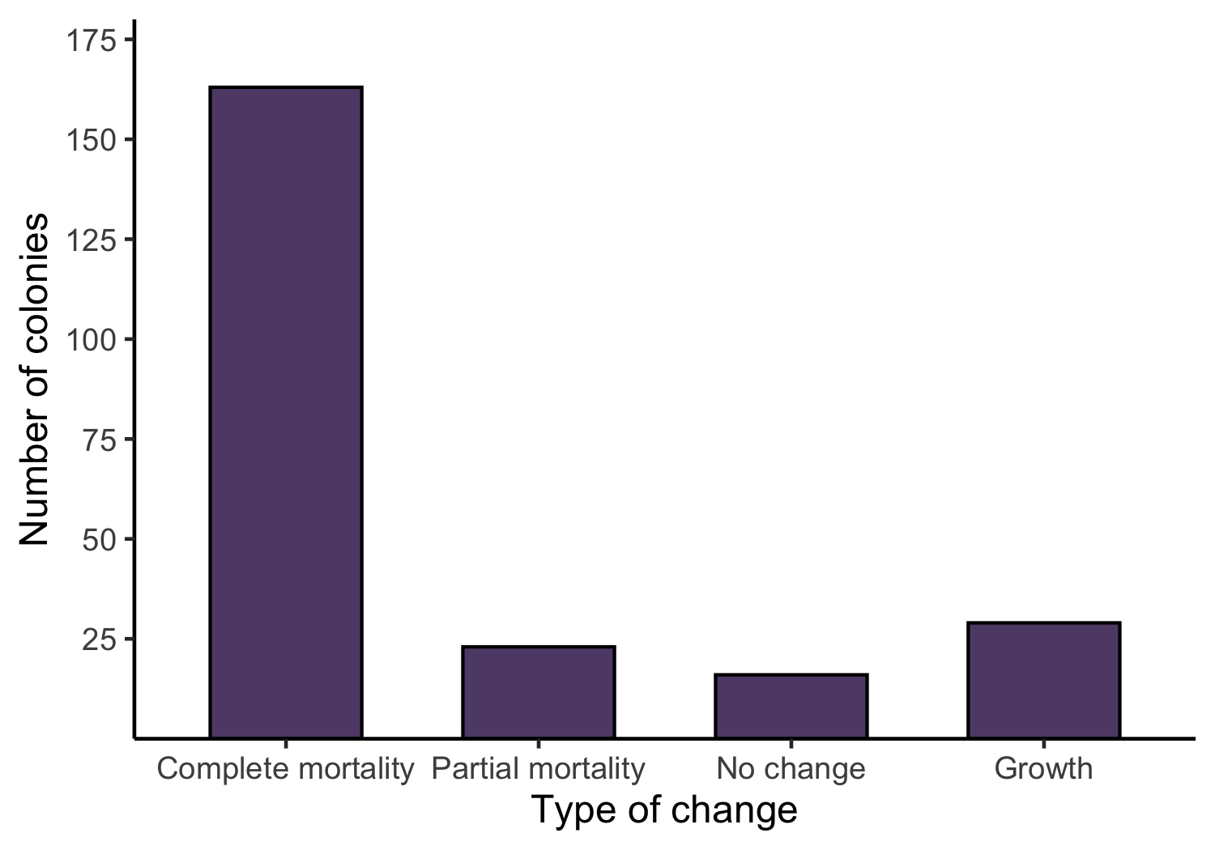
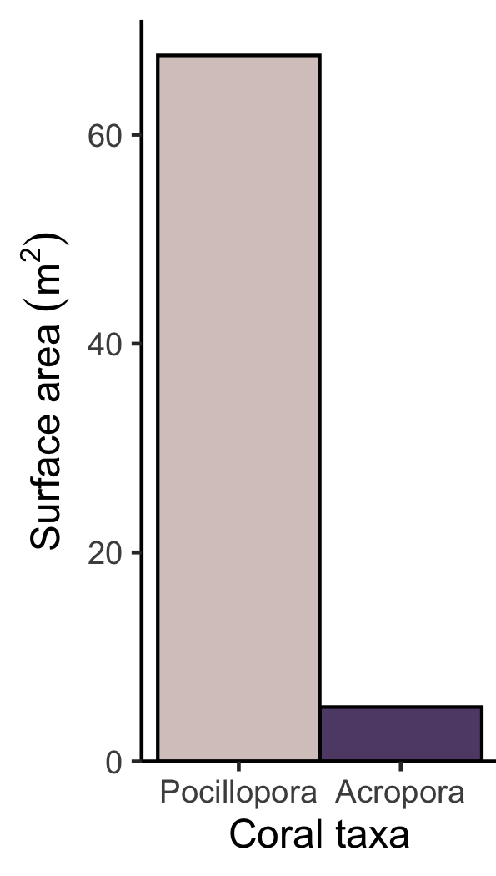
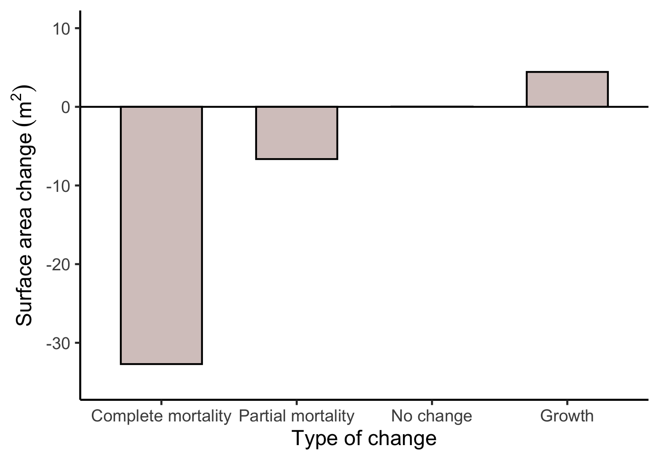
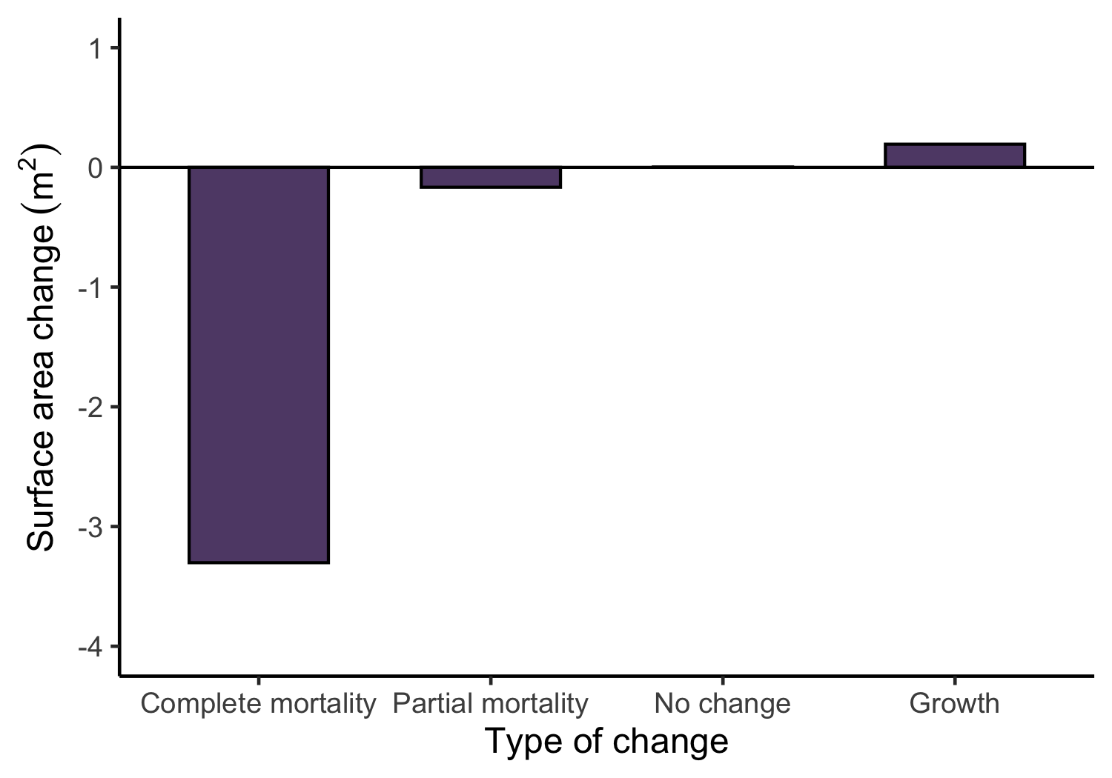
Figure 2
a) Pre-disturbance (2018)
b) Change through disturbance (2018-2019)

Slide 3
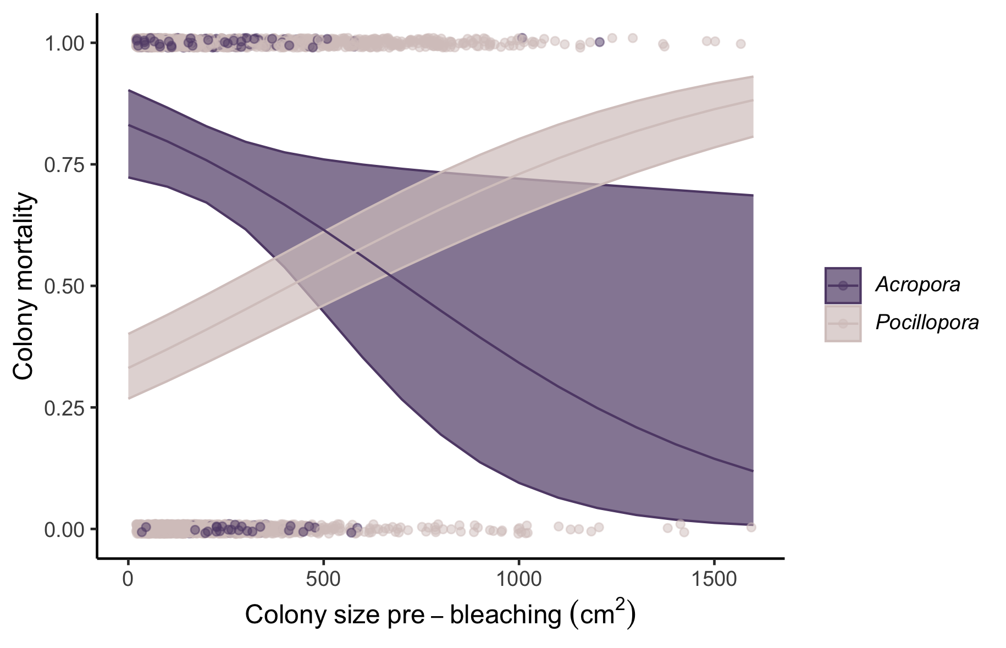
Figure 3
All colonies with live tissue > 50% considered to have survived

Slide 4
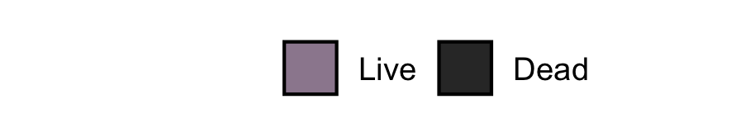
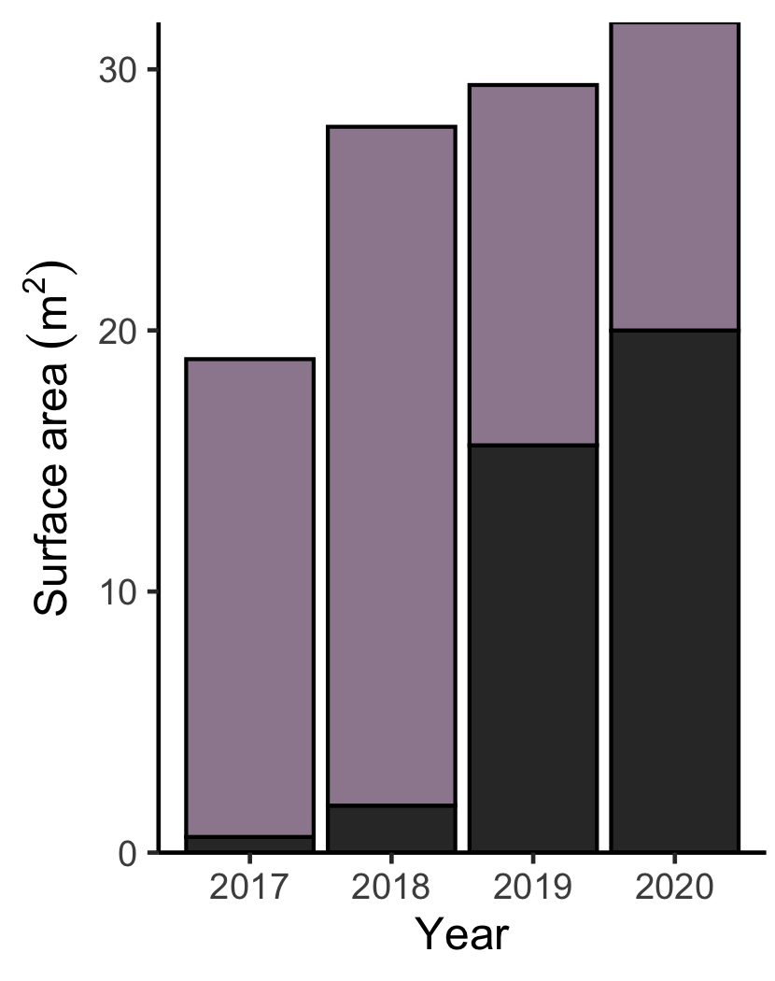
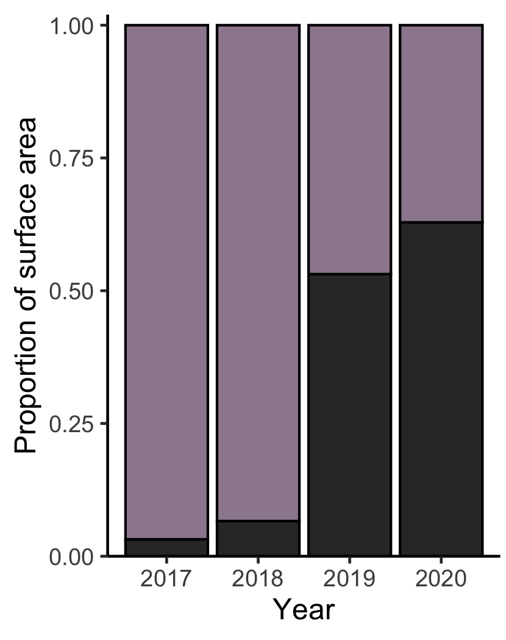
Notes:
Combine acropora and pocillopora into a live coral category

Slide 5
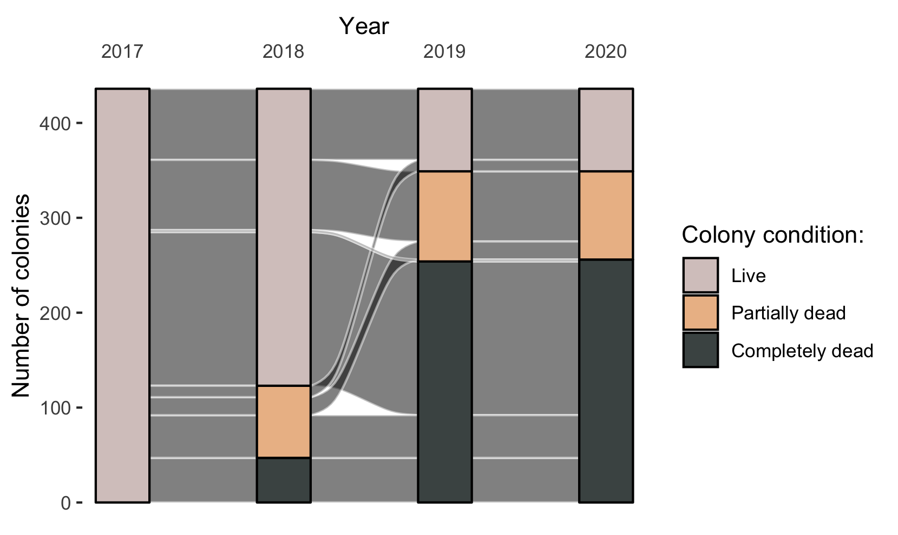
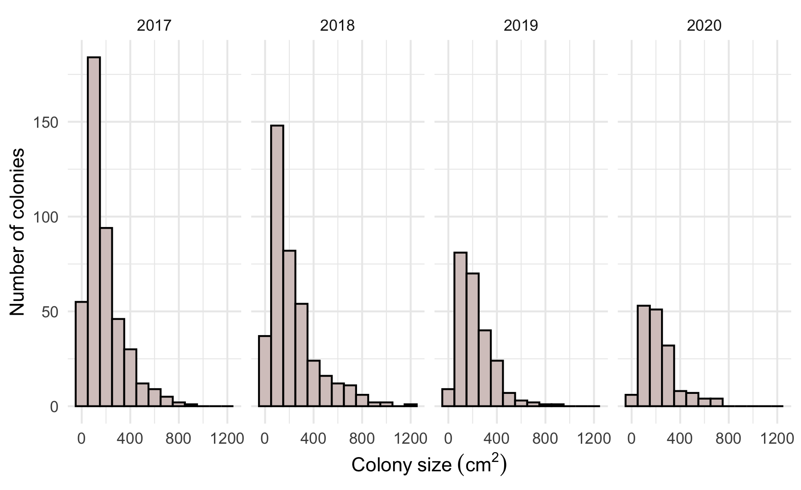

Slide 6
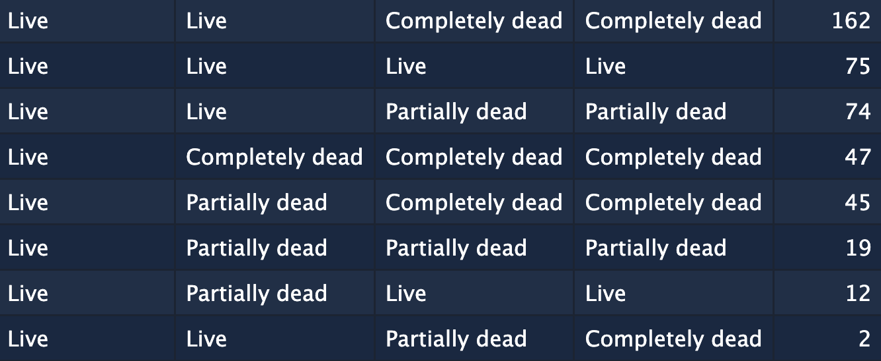

Slide 8
Lines up with Sankey diagram; follows size structure of colonies that survived but does not allow for new colonies

Slide 9
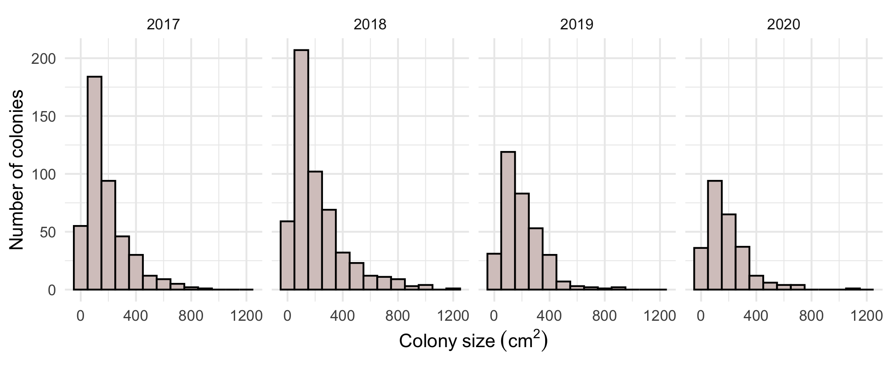
Figure 6
Allows for addition of new colonies that enter minimum size class

